Slide 1
Arrays in Detail

Slide 2
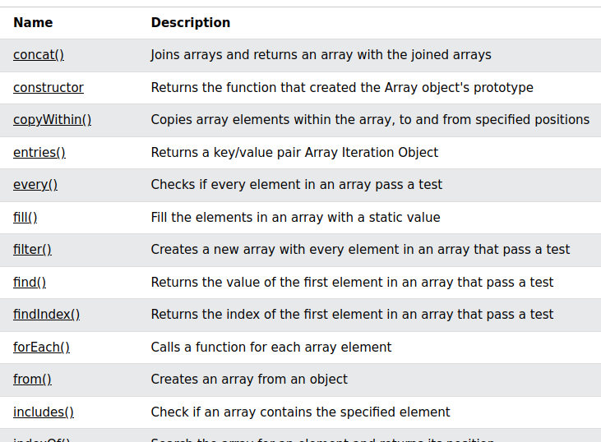
Array Ref: https://www.w3schools.com/jsref/jsref_obj_array.asp

